Slide 1
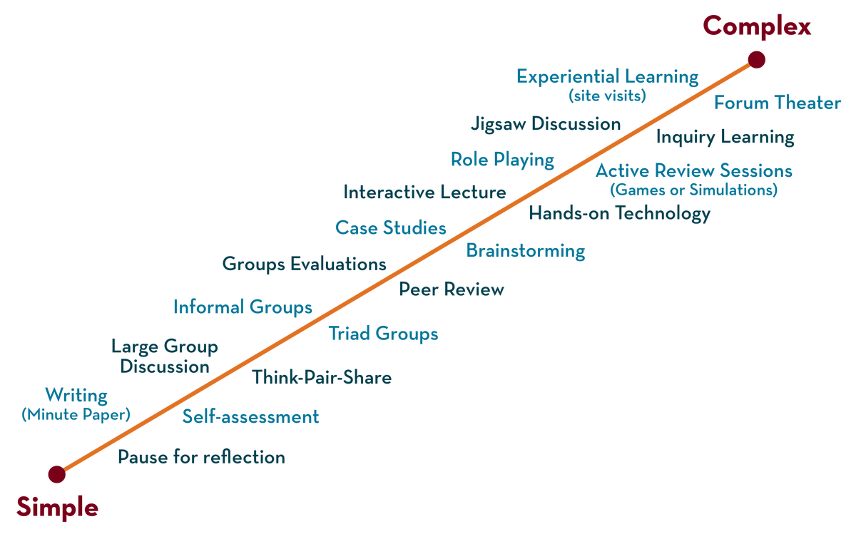
COURSE NAME : Operating Systems COURSE CODE: 21CS2109RA Topic: INTRODUCTION TO OPERATING SYSTEM
Department of CSE-H

Slide 2
AIM OF THE SESSION
To familiarize students with the basic concept of Introduction to Operating System.
INSTRUCTIONAL OBJECTIVES
This Session is designed to:
Demonstrate Types of Operating Systems.
Describe what an operating system is.
List out the different types of operating systems.
Describe the role of an operating system.
A Case Study of Operating Systems: Dos, Windows, UNIX, Linux, Mac, Android, and iOS.
LEARNING OUTCOMES
At the end of this session, you should be able to:
1. Defines Operating System Structure, Operating System Components, and OS Functions.
2. Describe the role of an Operating System and Types of operating systems.
3. A Comparative Study of Operating Systems Commands in Case of Dos and UNIX.
4. A Case Study of Different Flavors of Linux-based Operating Systems: Centos, Debian, Fedora, Kali Linux,
Ubuntu, and openSUSE.

Slide 3
SESSION DESCRIPTION
What is an Operating System?
Description of Computer System Structure related to OS.
Components of a Computer System.
What Operating Systems Do.
Functions of an Operating System.
Defining an Operating System.
Types of an Operating System.
A Case Study of Flavors of Different Unix based Operating Systems Oracle Solaris, FreeBSD, Microsoft Xenix, IBM AIX, HP UX.
A Comparative Study of Windows based Operating Systems: Windows 95, Windows 98, Windows CE, Windows 2000, Windows ME, Windows XP, Windows NT.

Slide 4
SESSION INTRODUCTION
History of Operating System:
Operating systems were first developed in the late 1950s to manage tape storage.
The General Motors and North American Aviation Research Lab implemented the first OS (GM-NAA I/O) in the early 1950s for their IBM 701 by Robert L. Patrick.
In the mid-1960s, operating systems started to use disks.
In the late 1960s, the first version of the Unix OS was developed.
The first OS built by Microsoft was DOS. It was built in 1981 by purchasing the 86-DOS software from a Seattle company.
The present-day popular OS Windows began in 1985 when a GUI was created and paired with MS-DOS.

Slide 5
SESSION INTRODUCTION
What is an Operating System?
A program that acts as an intermediary between a user of a computer and the computer hardware / An operating system is a program that controls the execution of application program and acts as an interface between the user of a computer and the computer hardware.
Operating system goals:
Execute user programs and make solving user problems easier.
Make the computer system convenient to use.
Efficiently use the computer hardware.
Purpose of an operating system:
The purpose of an operating system is to provide an environment in which a user can execute programs in a convenient and efficient manner.

Slide 6
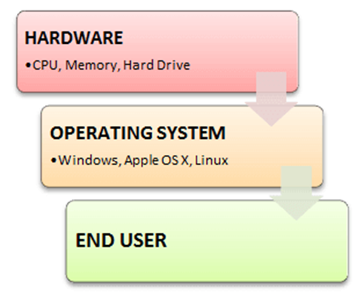
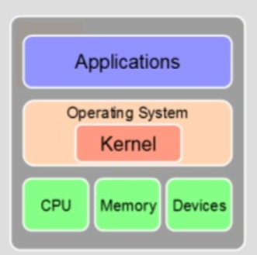
SESSION INTRODUCTION
An operating system is software that manages the computer hardware.
Another more common deﬁnition is that the operating system is the one program running at all times on the computer—Usually, it is usually called the kernel.
The kernel is the core that provides essential services for all other parts of the OS.
It is the primary layer between the OS and underlying computer hardware, and it helps with tasks such as process and memory management, file systems, device control, and networking.

Slide 7
ACTIVITIES/ CASE STUDIES/ IMPORTANT FACTS RELATED TO THE SESSION
A Case Study of Operating Systems: Dos, Windows, UNIX, Linux, Mac, Android, and iOS.
A Comparative Study of Operating Systems Commands in Case of Dos and UNIX.
A Case Study of Flavors of Different Unix based Operating Systems Oracle Solaris, FreeBSD, Microsoft Xenix, IBM AIX, HP UX (A/P).
A Case Study of Different Flavors of Linux based Operating Systems: Centos, Debian, Fedora, Kali Linux, Ubuntu, openSUSE. (A/P).
A Comparative Study of Windows based Operating Systems: Windows 95, Windows 98, Windows CE, Windows 2000, Windows ME, Windows XP, Windows NT.
ACTIVITY: - Create a Virtual Machine and Install Linux

Slide 8
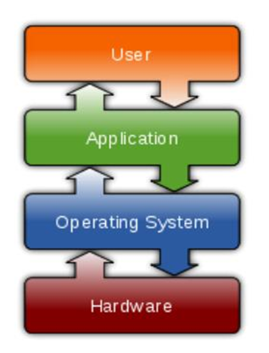
SESSION DESCRIPTION
OPERATING SYSTEMS
Manages directories, folders and files.
Manages memory.
Manages hardware and software.
Provides computer networking functions.
Example: Windows, DOS, Linux, Ubuntu.

Slide 9
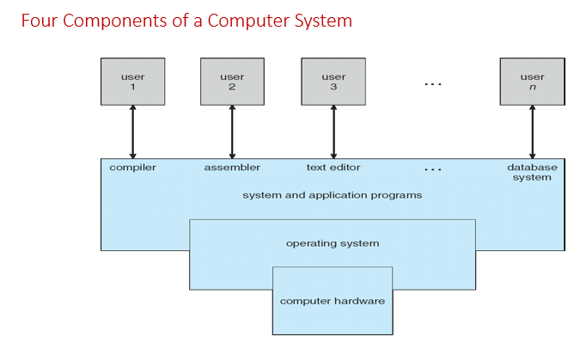
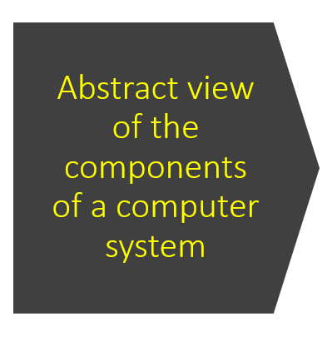
SESSION DESCRIPTION

Slide 10
SESSION DESCRIPTION
Computer System Structure
Computer System can be divided into four components
Hardware - Provides basic computing resources
Ex: CPU, Memory, I/O devices
Operating System - Controls and coordinates use of hardware among various applications and users
Software - It is a set of programs, procedures and routines that instructs a computer system what to do. Two types of software's are System Software and Application Software.
System Software : It is a set of computer programs, which is designed to manage system resources usually written using low level language.
Ex : linkers, loaders, assemblers, kernel programs etc.
Application Software: Define the ways in which the system resources are used to solve the computing problem of the users.
Ex: Word Processors, compilers, web browsers, database systems, video games.
Users - Who utilizes a computer
Ex : People, Machines, Other Computers.

Slide 11
SESSION DESCRIPTION
What Operating Systems Do
The operating system controls the h/w and coordinates its use among the various application programs for the various users.
We can also view a computer system as consisting of h/w, s/w and data.
The operating system provides the means for proper use of these resources in the operation of the computer system.
To understand more fully the operating system's role, we explore operating systems from two view points:
The user.
The system.

Slide 12
SESSION DESCRIPTION
User View
The User's view of the computer varies according to the interface being used.
Single User Computers(e.g., PC, Workstations) : Such systems are designed for one user to monopolize its resources. the goal is to maximize the work(or play) that the user is performing. the operating system is designed mostly for ease of use and good performance.
Muti User Computers(e.g., Mainframes, Computing servers): These users share resources and may exchange information. the operating system in such cases is designed to maximize resources utilization - to assure that all available CPU time, memory and I/O are used efficiently and that no individual users take more than their air share.
Handheld Computers (e.g., Smartphones and tablets): The user interface for mobile computers generally features a touch screen. The systems are resource poor, optimized for usability and battery life.
Embedded Computers (e.g., Computers in home devices and automobiles) The user interface may have numeric keypads and may turn indicator lights on or off to show status. The operating systems are designed primarily to run without user intervention.

Slide 13
SESSION DESCRIPTION
System View
From the computer's point of view, the operating system is the program most intimately involved with the hardware.
There are two different views:
The operating System is a resource allocator
Manages all resources
Decides between conflicting requests for efficient and fair resource use
The operating system is a control program
Controls execution of programs to prevent errors and improper use of the computer

Slide 14
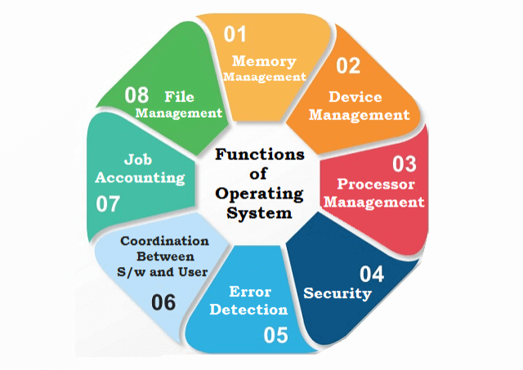
SESSION DESCRIPTION
Functions of Operating System:

Slide 15
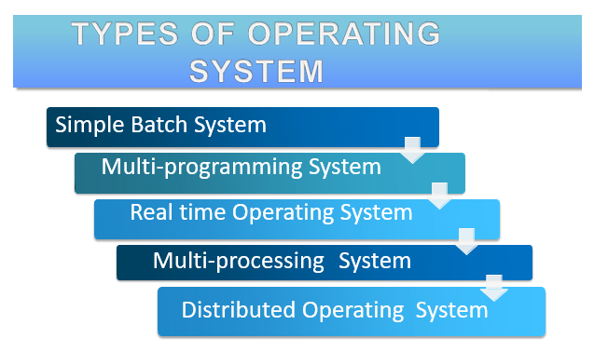
SESSION DESCRIPTION

Slide 16
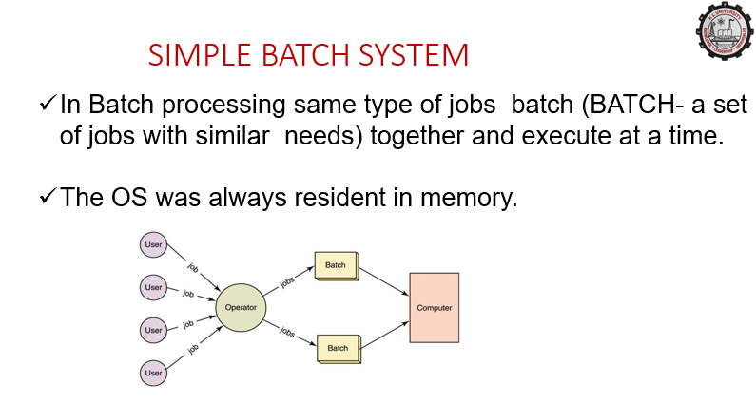

Slide 17
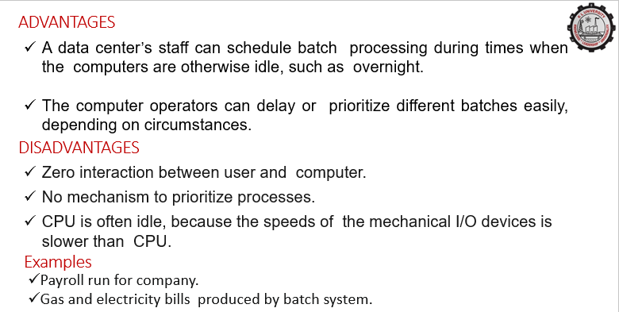

Slide 18
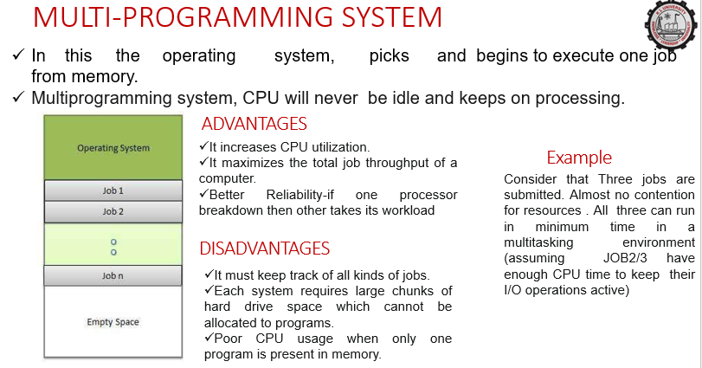

Slide 19
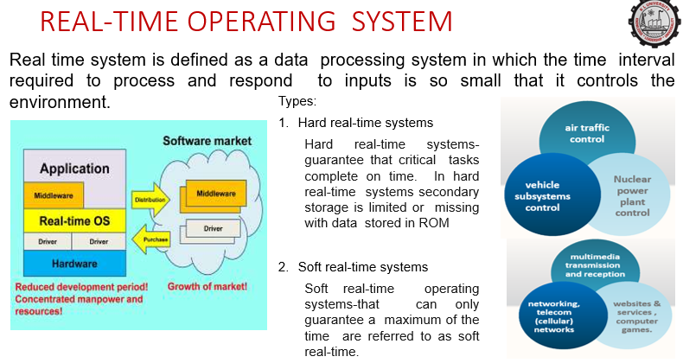

Slide 20
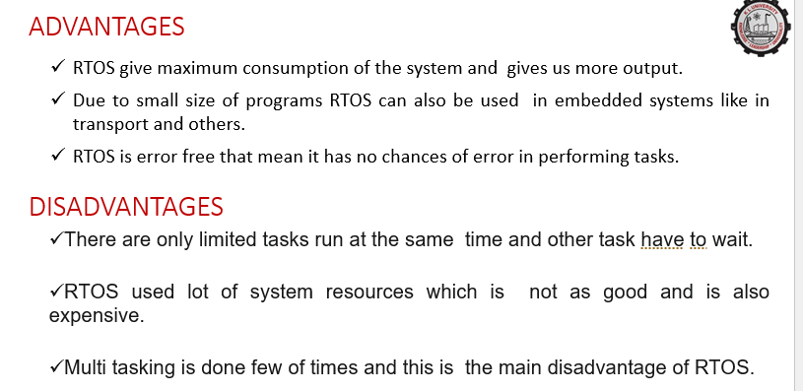

Slide 21
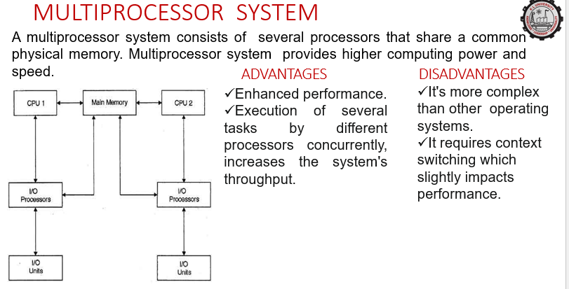

Slide 22
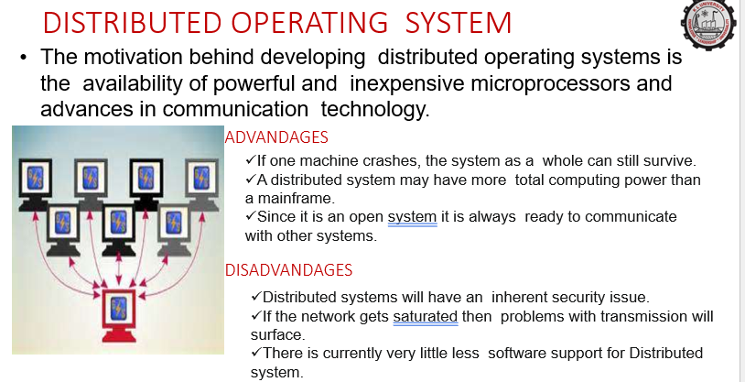

Slide 23
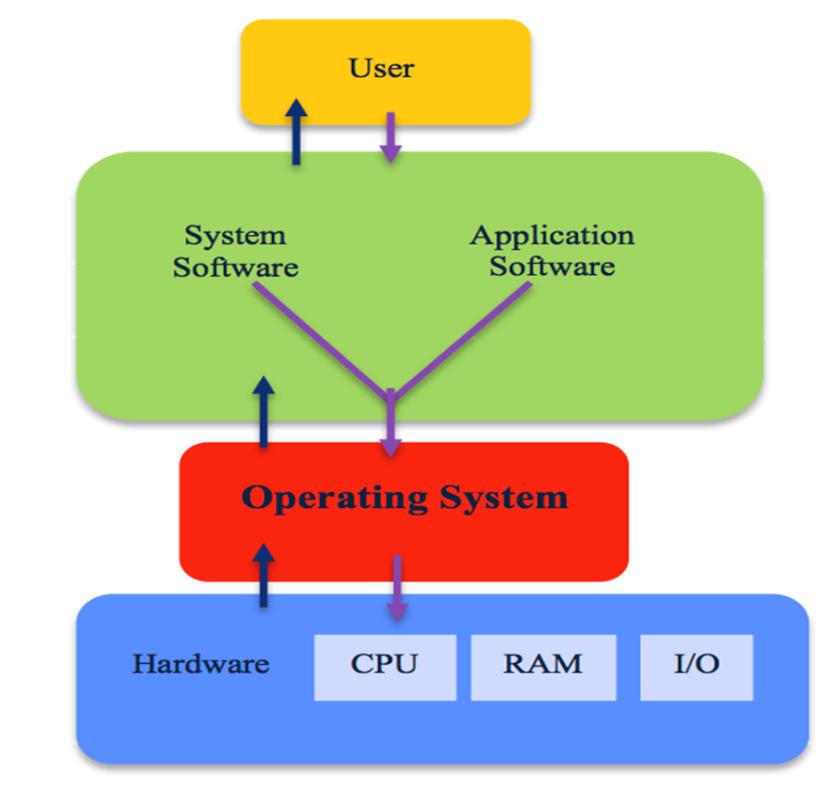
SESSION DESCRIPTION
The Operating System provides various types of services
I/O operation
Program execution
File system manipulation
Communication
Error Handling
Resource allocation
Accounting
Protection
Operating System Components
Process Management
File Management
Network Management
Main Memory Management
Secondary Storage Management
I/O Device Management
Security Management
Command Interpreter System
Needs of operating system
Managing Input-Output Unit
The Operating system as a platform for application programs
Multitasking
Consistent user interface

Slide 24
EXAMPLES
Examples of Operating System Dos, Windows, UNIX, Linux, Mac, Android, & iOS. Oracle Solaris, FreeBSD, Microsoft Xenix, IBM AIX, HP UX. Centos, Debian, Fedora, Kali Linux, Ubuntu, openSUSE.

Slide 25
SUMMARY
An Operating System (OS) is an interface between a computer user and computer hardware. An operating system is a software which performs all the basic tasks like file management, memory management, process management, handling input and output, and controlling peripheral devices such as disk drives and printers.
An operating system is software that enables applications to interact with a computer's hardware. The software that contains the core components of the operating system is called the kernel.
The primary purposes of an Operating System are to enable applications (software's) to interact with a computer's hardware and to manage a system's hardware and software resources.

Slide 26
SELF-ASSESSMENT QUESTIONS
Unix is written in which language?
C
Java
C++
Python
Which of the following is not a variants of Unix?.
Solaris
AIX
BSD
SOL

Slide 27
TERMINAL QUESTIONS
Describe in detail about operating system.
List out the functions of operating system.
Analyze role of different types of operating systems.
Summarize what an operating system do.

Slide 28
REFERENCES FOR FURTHER LEARNING OF THE SESSION
Reference Books:
Arpaci-Dusseau, Remzi H., and Andrea C. Arpaci-Dusseau. Operating systems: Three easy pieces. Boston: Arpaci-Dusseau Books LLC, 2018. http://pages.cs.wisc.edu/~remzi/OSTEP/
Silberschatz, Abraham, Peter B. Galvin, and Greg Gagne. Operating system concepts. 10th edition, John Wiley & Sons, 2018.
Tanenbaum, Andrew. Modern operating systems. Pearson Education, Inc., 2009.
Sites and Web links:
https://www.cse.iitb.ac.in/~mythili/os/
https://cse.iitkgp.ac.in/~sumantra/courses/os/os_pg.html
https://www.cse.iitd.ernet.in/os-lectures

Slide 29
THANK YOU
Team – Operating System

